Slide 1
Uno Feature - Covey.Town
CS4530: Group 608 - Christina Medeiros, Ike Kaper, Oliver Nemec, Inbar Ofer

Slide 2
Description Of Added Feature
Uno Card Game Implementation
Users enter covey town and join a game or start a new one
Players have access to a tutorial that summarizes the game rules and standard play
Players have the opportunity to play cards from their hand into the game on their turn or draw and view the leaderboard
Our primary aim in Uno was to alleviate the challenge of limited engagement and social interaction in Covey.Town by introducing Uno as a universally cherished, accessible, and immersive game, ultimately elevating the user experience and strengthening the platform's community bonds.

Slide 3
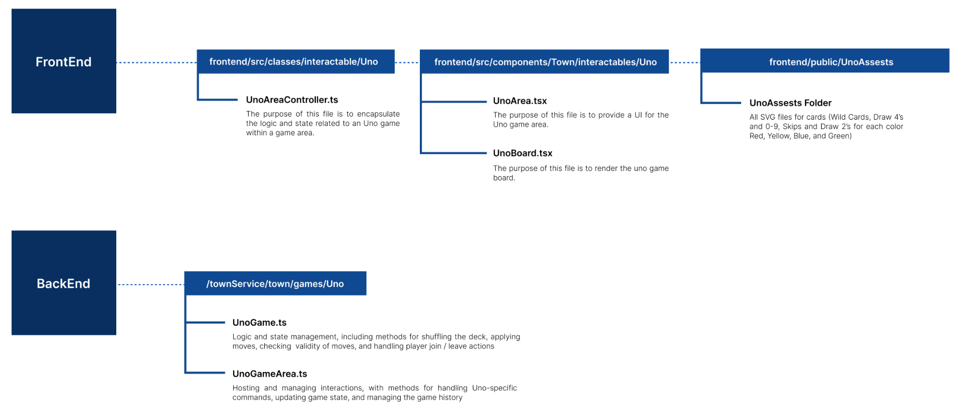
Tech Stack and Design Decision
Although any and all design can be iteratively improved, we believe this was the right design for several reasons. Drawing inspiration from prior successful implementations saved development time and ensure a consistent coding style across different parts of the project. Moreover, we have a clear separation of concerns when it comes to our design decisions. The division of responsibilities between frontend and backend files is apparent. This separation of concerns promotes a modular and maintainable codebase, making it easier to debug, test, and extend functionality in the future.

Slide 4
Challenges and Overcoming Them
Technical Challenge: One technical challenge we faced was initially getting Covey.Town to render / issues having backend code connect code to the frontend code so we could actually start testing things in rapid iteration. Due to the hold up in rapid iteration, we could not start our debugging process until later than we had originally intended. Although we stand by our planned design decisions for our code connections , the right one definitely took longer.
Logistic Challenge: We had initially set up daily discord communications and frequent virtual meetings, but were still having trouble figuring out the scope of what our task responsibilities are. During sprint 2, we realized that meeting in person worked well for us. Moving forward in the project, we knew that this was the best way to prioritize our responsibilities.
Setup Challenge: We originally had some issues finding proper svg files for each of our uno cards. To get around this, we parsed an svg file (which included all 108 cards) to separate them into individual cards. We then had to format them to be visually acceptable, in which this design decision was crucial to ensure proper and appealing game play.

Slide 5
Member Contribution
Oliver: Setup initial codebase and github action CI/CD. Active role in developing frontend. Assisted in developing and debugging backend.
Ike: Led conceptual discussion of how to structure our implementation. Active role in developing backend and controller code. Active role in non code deliverables. Assisted in debugging frontend.
Inbar: Active role in frontend development. Primary role in debugging issues with code, mostly related to async and useEffect propagation issues
Christina: Active role in all UX/UI centered tasks, utilizing extensive HCI background. Assisted with backend and controller code. Lead non code deliverables.

Slide 6
Live Demo!
Now, for the live demonstration…

Slide 7
Thank you!
Covey.Town Uno Implementation
Christina Medeiros, Ike Kaper, Oliver Nemec, Inbar Ofer

